Slide 1
Architecting Microservices

Slide 2

Evolving towards microservices
Microservices are autonomous Microservices own their data
Overview
Microservices are independently deployable
Identifying microservice boundaries

Slide 3

What if I already have an existing (monolithic) application?

Slide 4

Evolving towards Microservices
Augment a monolith
Add new microservices
Decompose a monolith
Extract microservices
You don’t need to start with microservices
It’s hard to get service boundaries right
Defining microservice responsibilities
Public interface

Slide 5

Microservices own their own data

Slide 6






Microservice Data Ownership
Avoid sharing a data store
Limitations:
Database joins
Transactions
Eventual consistency
Data store per microservice

Slide 7
Define service boundaries well
Mitigating
Data Ownership Limitations
Minimize the need to aggregate data
Caching
Improved performance
Improved availability
Identify “seams” in the database

Slide 8
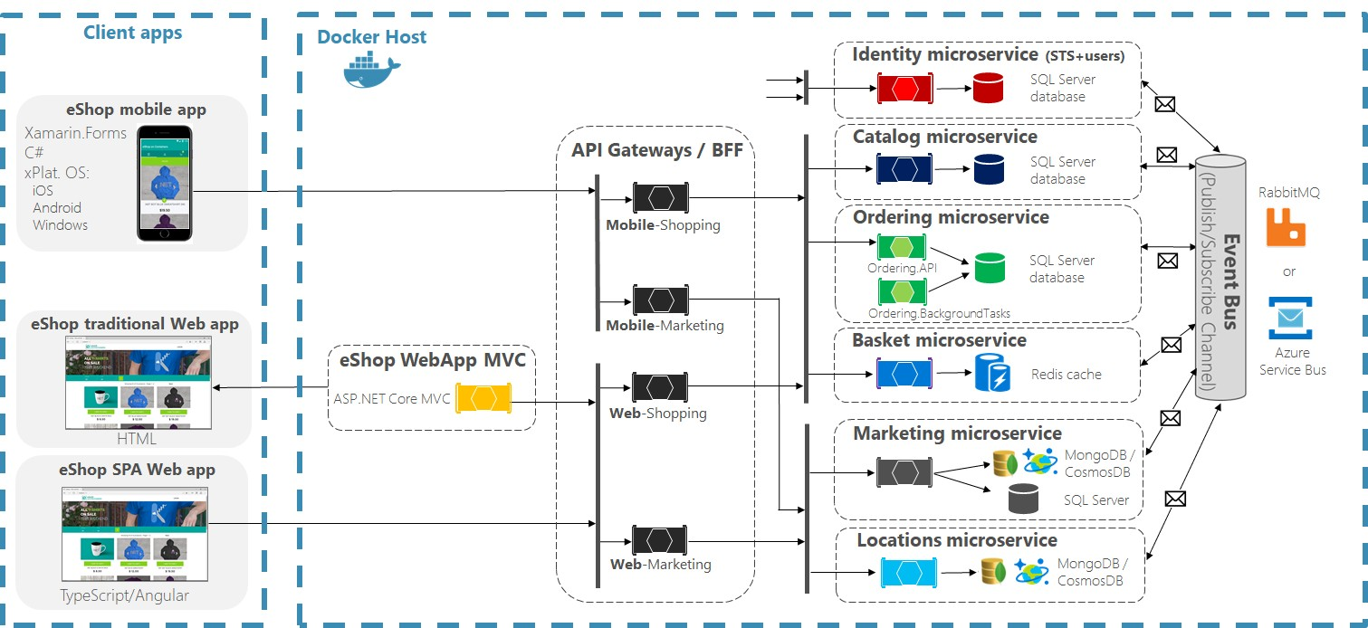

eShopOnContainers Architecture

Slide 9

Duplicating Data
Ordering Microservice
Get name & price
Catalog Microservice
OrderItem
ProductId
ProductName
UnitPrice
CatalogItem
Id
Name
Price
Correct at time of placing order
denormalization
Order database
Catalog database

Slide 10
Microservices can consist of more than one process

Slide 11
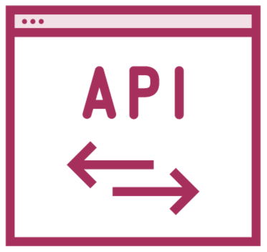
Microservice Components
Microservice
Code
Database

Slide 12
Microservice Components
Microservice
Scale out

Slide 13
Microservice Components
Microservice
Database sharding or replication

Slide 14

Microservice Components
Microservice
Scheduled task

Slide 15


Microservice Components
Microservice
Message processor

Slide 16
eShopOnContainers Architecture

Slide 17
Microservices should have a clearly defined public interface

Slide 18
Microservices can be upgraded without their clients needing to upgrade

Slide 19

Microservice Contracts
Make additive changes
New endpoints
New properties on DTOs
Introduce version 2 API
Version 1 clients must still be supported
Easily forgotten in development

Slide 20

Avoiding Upgrade Issues
Team ownership of microservices
First, add a new capability
Then, deploy updated microservice
Later, update clients
Create automated tests
Ensure that older clients are supported
Run as part of a CI build process
Beware of shared code
Can result in tight coupling

Slide 21

Identifying Microservice Boundaries
Getting it wrong can be costly
Poor performance
Hard to change
Start from an existing system
Identify loosely coupled components
Identify database seams

Slide 22
Organize microservices around business capabilities

Slide 23
Identify “bounded contexts”
Break up large domains
“Ubiquitous language”
Microservices do not share models
e.g. OrderItem and CatalogItem
Sketch your ideas on a whiteboard
Run them through real-world use cases
Identify potential problems
Domain Driven Design

Slide 24

Microservice Boundary Pitfalls
Don’t turn every noun into a microservice
Anemic CRUD microservices
Thin wrappers around databases
Logic distributed elsewhere
Avoid circular dependencies Avoid chatty communications

Slide 25
eShopOnContainers Service Boundaries
Catalog
Basket
Ordering
Catalog
Basket
Ordering
Browsing for products Large dataset
Support flexible queries
Non-sensitive data
Preparing for purchase Short-lived data
Redis cache
Processing orders Mostly writes new data
RTeleiabmilitpy ios vritaalrily H_{U}igh_{n}ly_{a}se_{v}n_{a}sit_{i}i_{l}v_{a}e d_{b}at_{l}a_{e}
Identity
Marketing
Location
Ordering
Catalog
Basket
Authentication
Email campaigns
Customer locations

Slide 26
How would you break your application into microservices?

Slide 27


Slide 28
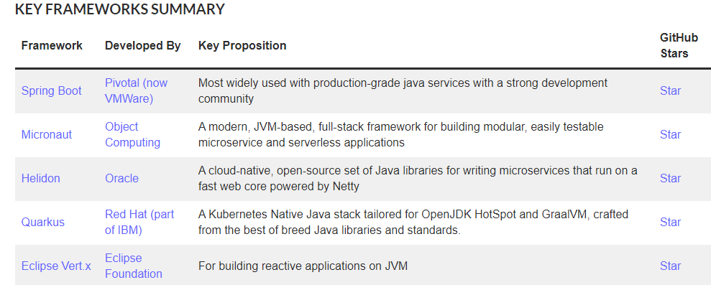

Slide 29
Evolving towards microservices
Microservices own their own data
Microservices may consist of multiple processes
Microservices should be independently deployable
Avoid breaking changes
Identify “bounded contexts” for microservice boundaries
Getting boundaries right is important
Summary

